Slide 1

Presentation on
Project Exhibition - 2
Over Voltage And Under Voltage Protection System
Review - 1
School of Electrical and Electronics
VIT Bhopal university
Presented by
Prashasti Singh Gautam – 19BEE10028
Tekumalla Lakshmi Sowjanya –19BEE10023
Samiksha Dash – 19BEE10009
Under the guidance of
DR. Om Prakash Pahari

Slide 2
Contents
Introduction
Undervoltage
Overvoltage
Why we need protection?
Literature review
Components
Block diagram
Project scope
Advantages
Drawbacks
Objective
Work plan

Slide 3
If any unexpected fluctuation in the power supply may cause many problems in the industries, homes, offices. Voltage fluctuations in the electric power supply have a very poor effect on connected load.
These fluctuations of over voltage and under voltage protection system are produced by many reasons which are like voltage surges, limiting, overload and etc..
Applications of these systems are :
1. used in the home appliances
2. used in industries to control the voltage fluctuations.
3. Protection of sensitive electronic devices.
4.Agriculture motors.
5.Water pumps etc..
INTRODUCTION

Slide 4
UNDER VOLTAGE
Undervoltage occurs when the average voltage of a three-phase power system drops below intended levels, and is sometimes referred to as a brown-out.
Electromechanical devices, including three phase motors and pumps, are designed to be operated at very specific voltage levels. If these devices are allowed to operate at reduced voltage levels they will draw higher currents.
The increase in current causes increased heat in the winding and coils of the equipment damaging the critical insulation protecting them.
Operating in Undervoltage conditions can drastically reduce the life of the electromechanical equipment and lead to premature failure.

Slide 5
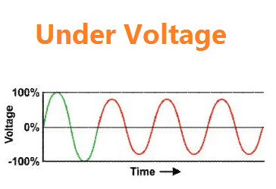
CAUSES FOR UNDER VOLTAGE
There are various causes for which under voltages are created in system voltage.
1.Closing and opening of circuit breakers.
2. Due to fault
3.Due to motor starting
4.Due to transformer energizing

Slide 6
OVERVOLTAGE
Overvoltages are all voltages that temporarily surpass the threshold value of the mains voltage.
However, overvoltages can not only occur in the 230 V (normal household power supply voltage) mains, but can also reach the connected devices via telephone or aerial cables.
Overvoltages first hit the sensitive system parts. The tiny electronic circuits on circuit boards, motherboards, network adapters, etc. cannot cope with any additional current and voltage peaks.

Slide 7
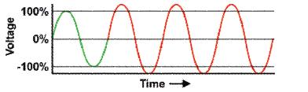
Over voltage
Without effective protection, the overvoltages destroy sensitive electronic components in the circuits of the connected appliances.
Overvoltages can be caused, for example, by switching impulses of powerful engines, welding equipment or other large electric appliances.
The most dangerous causes are very high voltage peaks caused by indirect lightning strikes. They mean the sure end of unprotected electric appliances.

Slide 8
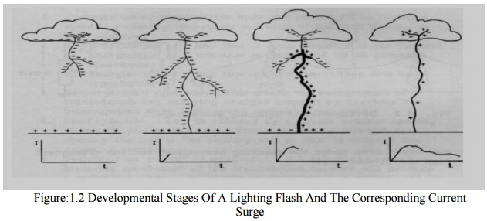
CAUSES OF OVERVOLTAGE
1. Over voltage are less common than under voltage , but they also arise due to system faults.
2.Overvoltage can occur due to single line to ground fault, which in turn will raise the voltage of the other phases.
3.It can also cause due to disconnection of heavy industrial loads or switching on the capacitor banks.
4. lightening.

Slide 9
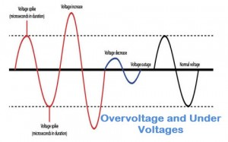
In many of the homes and industries fluctuations in AC mains supply take place frequently. The electronic devices get easily damaged due to fluctuations.
The number of expensive electronic devices in private households has risen sharply in the last few years. In addition, electric appliances are becoming ever smaller and more powerful; however, they thus also react more sensitively to overvoltage.
Over voltage protection is a power supply feature which shuts down the supply, or clamps the output, when the voltage exceeds a preset level.
UNDER VOLTAGE AND OVERVOLTAGE PROTECTION

Slide 10
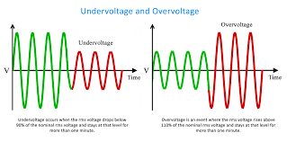

Slide 11
Literature Review
The irregularity in voltage is the major issue facing industry and home today and often times, is responsible for damaging valuable electrical equipment.
Electrical Power System protection device is required for protection of both user and the system equipment from fault.
Undesirable over and under voltage conditions, as well as surges caused due to sudden failure of mains power supply.
Here, we are designing a system which is completely smart, it can be used directly as stand-alone equipment between the mains supply and the load, or it may be inserted between an existing automatic/manual stabilizer and the load.
The device is automatic, efficient, simple and can precisely show the status of voltage on LCD.

Slide 12
Components
Transformer
Bridge rectifier
Regulator
Op-Amps
Arduino UNO
Liquid crystal display
Relay
Relay driver

Slide 13
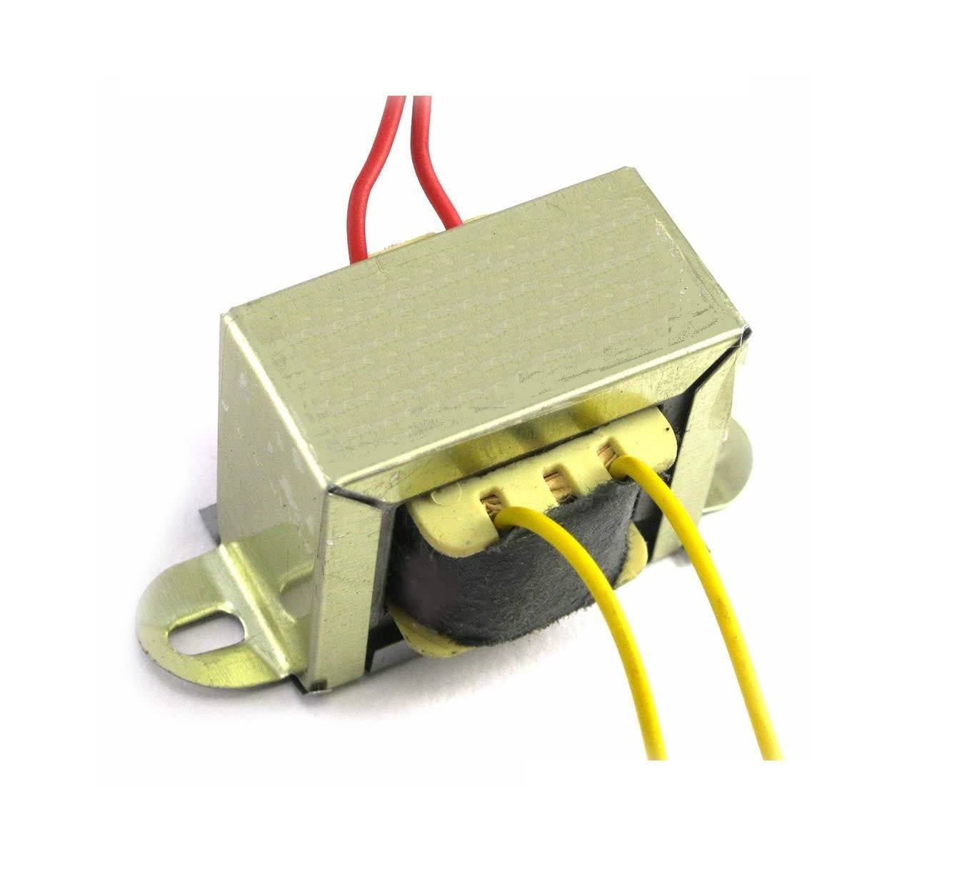
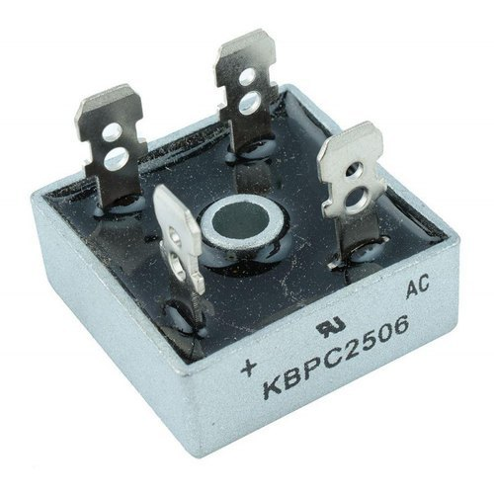
Transformer: Steps down the 220V ac into 15V ac on the principle of mutual induction.
Bridge rectifier: Full wave bridge rectifier converts the converts AC into DC for supplying the power to whole components of the system.

Slide 14
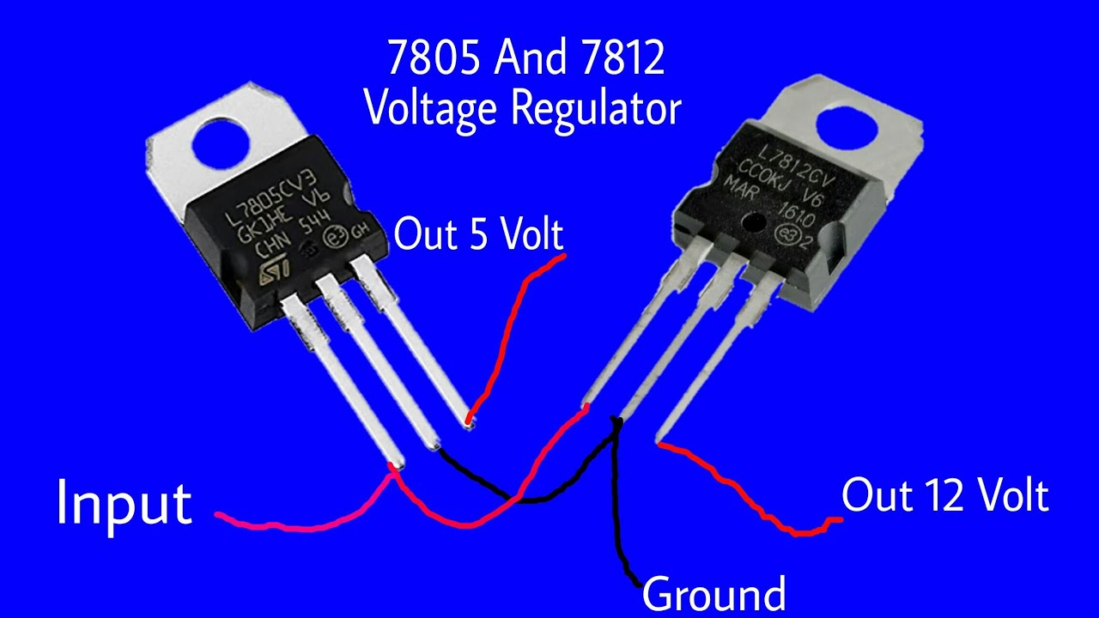
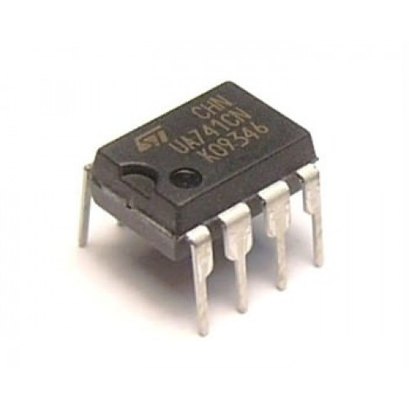
Regulator: Two voltage regulators LM7805 and LM7812 are used to give the regulated output voltage of 5V and 12V respectively
Op - Amps: LM741 is used in signal conditioning circuit, to provide rms value to arduino.

Slide 15
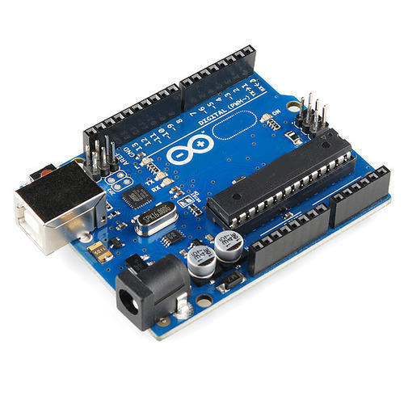
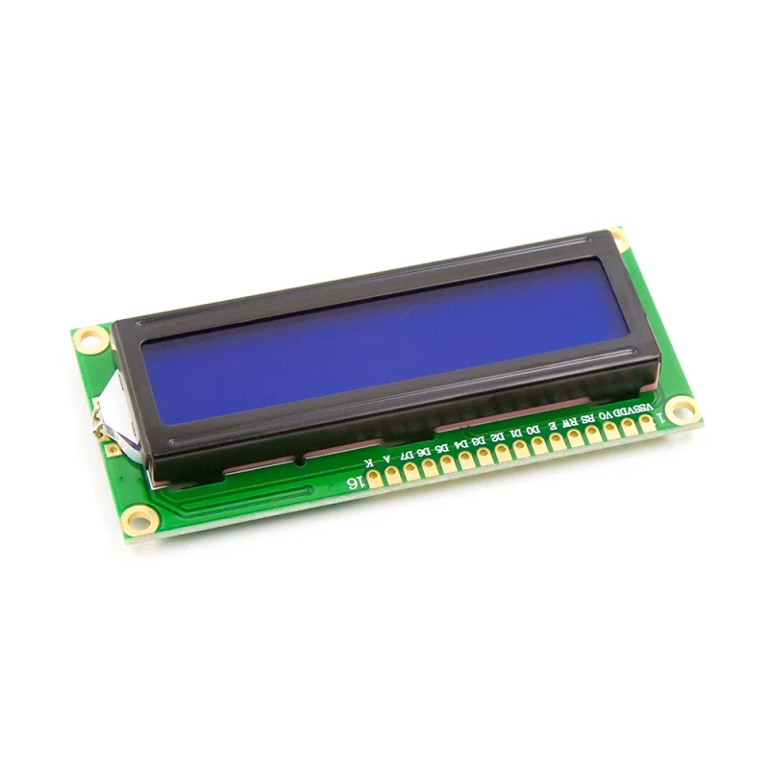
Arduino UNO R3: It is used to make this project intelligent and smart. It can take control actions automatically in case of under and over voltage.
LCD: It is used to display the input mains voltage level.It is 16 pin LCD powered up with 5V dc supply. It is interfaced with microcontroller.

Slide 16
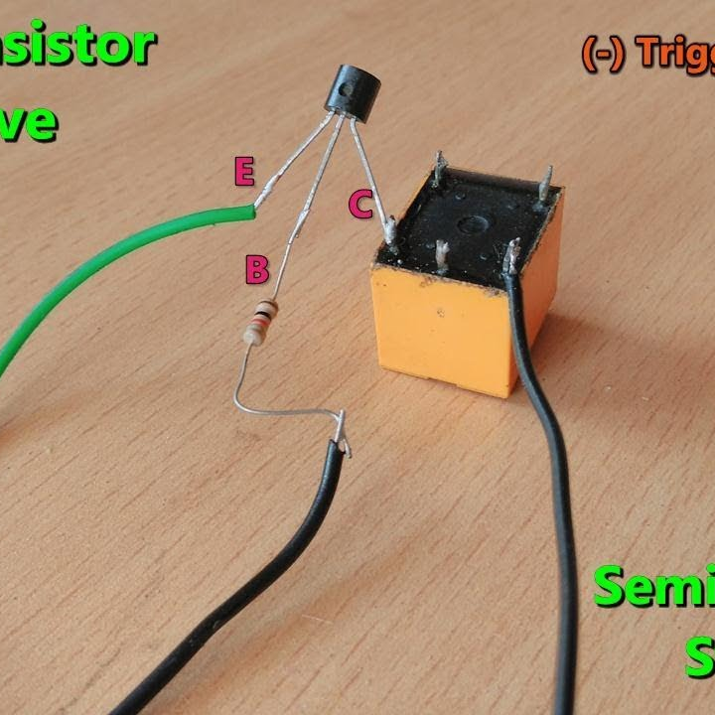
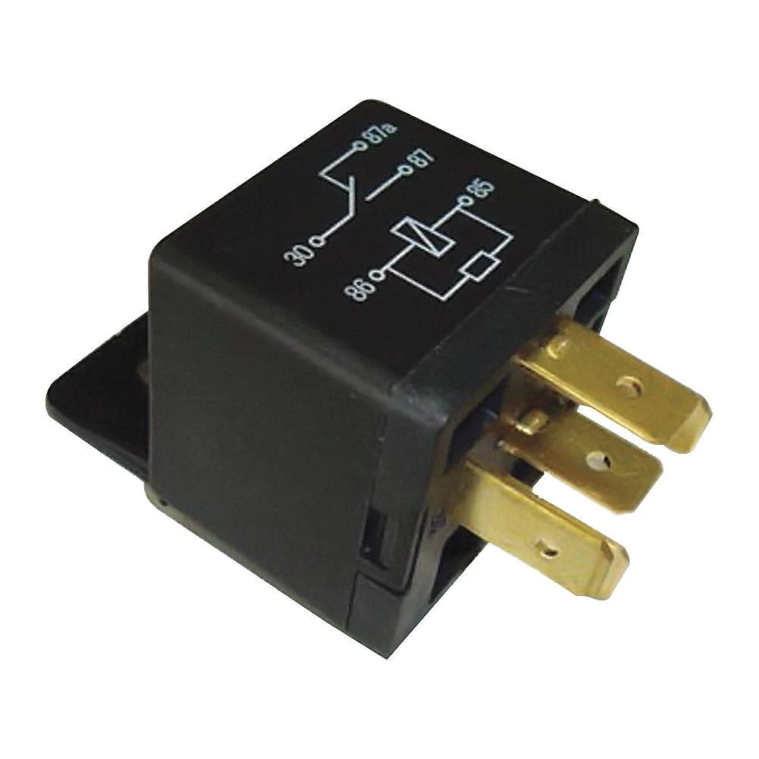
Relay driver: To give proper voltage or current to a relay a relay driver is used. It is made by using one transistor with a resistance.
Relay: Relays are electrically operated switches that open and close the circuits by receiving electrical signals from outside sources.

Slide 17
Block diagram
AC
Voltage sensor
Signal Conditioning circuit
AC
Power Supply
Regulator
Arduino
Liquid Crystal Display
Relay
Relay Driver
Load

Slide 18

SCOPE
The scope of this project is to add automatic functionality to turn off and turn on main power supply to home devices in case of over voltage and under voltage of main power supply.

Slide 19

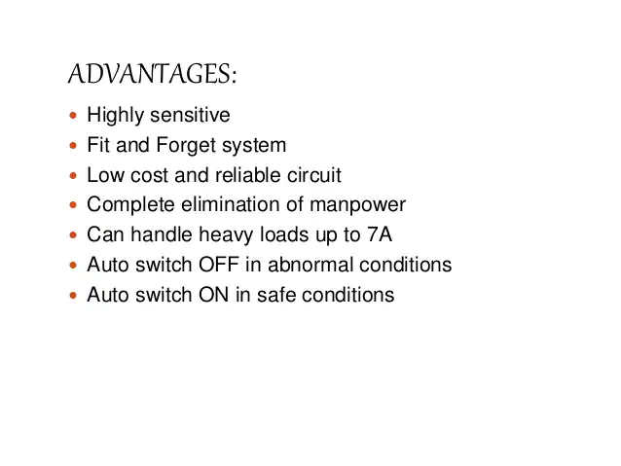
ADVANTAGES

Slide 20
DRAWBACKS
Insulation failure of the equipments.
Malfunction of the equipments.
Leads to losses in the electrical circuit.
Wastage of power.
Fluctuations can cause great impact to the power quality.

Slide 21
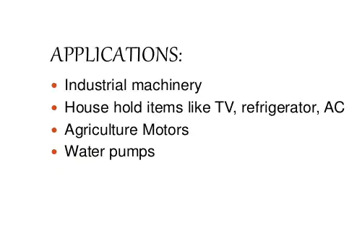

Slide 22
Objective
Building a device to protect electrical equipment from over voltage and under voltage.

Slide 23
S.N. | WORK BREAKDOWN STRUCTURE/MODULES |  | PROPOSED DATE FOR COMPLETION
1. | Research |  | 30/09/2021
2. | Circuit designing |  | 15/10/2021
3. | Simulation |  | 10/12/2021
4. | Calculations |  | 13/11/2021
5. | Coding |  | 15/12/2021
6. | Completion of project Report |  | Dec 2021
WORKPLAN

Slide 24
THANK YOU

Slide 25
Presentation on
Project Exhibition - 2
Over Voltage And Under Voltage Protection System
Review - 2
School of Electrical and Electronics
VIT Bhopal university
Presented by
Prashasti Singh Gautam – 19BEE10028
Tekumalla Lakshmi Sowjanya –19BEE10023
Samiksha Dash – 19BEE10009
Under the guidance of
DR. Om Prakash Pahari

Slide 26
If any unexpected fluctuation in the power supply may cause many problems in the industries, homes, offices. Voltage fluctuations in the electric power supply have a very poor effect on connected load.
These fluctuations of over voltage and under voltage protection system are produced by many reasons which are like voltage surges, limiting, overload and etc..
Applications of these systems are :
1. used in the home appliances
2. used in industries to control the voltage fluctuations.
3. Protection of sensitive electronic devices.
4.Agriculture motors.
5.Water pumps etc..
INTRODUCTION

Slide 27
Block diagram
AC
Voltage sensor
Signal Conditioning circuit
AC
Power Supply
Regulator
Arduino
Liquid Crystal Display
Relay
Relay Driver
Load

Slide 28
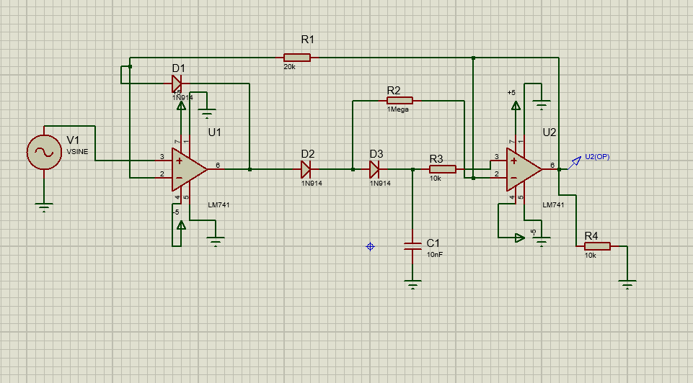
Signal Conditioning Circuit

Slide 29
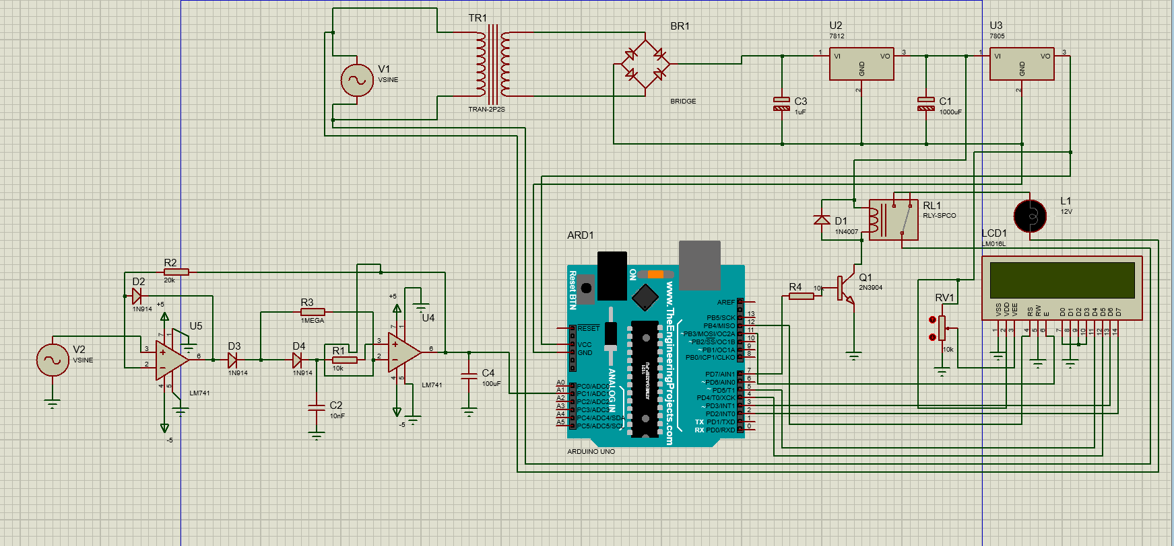

Slide 30
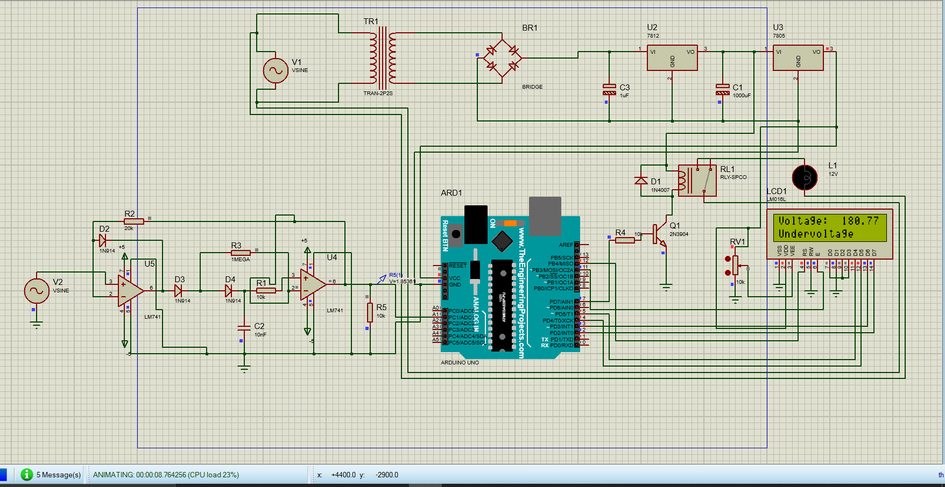
Under voltage condition

Slide 31

Normal voltage condition

Slide 32

Over voltage condition

Slide 33
References
[1] Manish Paul, Antara Chaudhury, Snigdha Saikia (2015), “Hardware
Implementation of Overvoltage and Under-voltage Protection”,IJIREEICE Vol. 3,
Issue 6, June 2015,
ISSN
(Online) 2321-2004.
[2] C. H. Vithalani, “Over Under Voltage Protection of Electrical Appliances”,
August 2003,
Electronics for You
[3] A. Ponnle and Omojoyegbe M. O,"Development of a Low Cost Microcontroller Based Under and Over VoltageProtection Device", International Journal of Scientific Engineering and Technology, Sept.,2014,Vol. No.3 Issue No.9, pp. 1225-1229.
[4] Kpochi Paul Kpochi "Microcontroller-based under and over voltage protection device..” American Journal of Engineering Research (AJER), vol. 7, no. 08, 2018, pp. 16-20
[5]https://www.ti.com/lit/an/snla140d/snla140d.pdf?ts=1639820604062&ref_url=https%253A%252F%252Fwww.google.com%252F

Slide 34
THANK YOU

Slide 35
Presentation on
Project Exhibition - 2
Over Voltage And Under Voltage Protection System
Final Review
School of Electrical and Electronics
VIT Bhopal university
Presented by
Prashasti Singh Gautam – 19BEE10028
Tekumalla Lakshmi Sowjanya –19BEE10023
Samiksha Dash – 19BEE10009
Under the guidance of
DR. Om Prakash Pahari

Slide 36
If any unexpected fluctuation in the power supply may cause many problems in the industries, homes, offices. Voltage fluctuations in the electric power supply have a very poor effect on connected load.
These fluctuations of over voltage and under voltage protection system are produced by many reasons which are like voltage surges, limiting, overload and etc..
Applications of these systems are :
1. used in the home appliances
2. used in industries to control the voltage fluctuations.
3. Protection of sensitive electronic devices.
4.Agriculture motors.
5.Water pumps etc..
INTRODUCTION

Slide 37
Block diagram
AC
Voltage sensor
Signal Conditioning circuit
AC
Power Supply
Regulator
Arduino
Liquid Crystal Display
Relay
Relay Driver
Load

Slide 39
ARDUINO CODE
#include <LiquidCrystal.h>
#define rs 12
#define en 11
#define d4 5
#define d5 4
#define d6 3
#define d7 2
#define HIGH 0x1
#define LOW 0x0
LiquidCrystal lcd(rs, en, d4, d5, d6, d7);
String TextForSms ;
int analogInput = A1;
float vout = 0;
int relay = 7;
int value = 0;
float vol = 0;
void setup() {
Serial.begin(9600);
lcd.begin(16, 2);
lcd.print("Voltage:");
pinMode(relay, OUTPUT);
pinMode(analogInput, INPUT);
}

Slide 40
ARDUINO CODE Cont…,
void loop()
{
value = analogRead(analogInput);
vout = (value / 1023.0)*5.0;
vol = vout*100;
lcd.setCursor(10,0);
lcd.print(vol);
if (vout > 2.6)
{
digitalWrite(relay,LOW);
lcd.setCursor(0,1);
lcd.print("Overvoltage");
}
if (vout<2.0)
{
digitalWrite(relay,LOW);
lcd.setCursor(0,1);
lcd.print("Undervoltage ");
}
if ((vout > 2.0)&&(vout<2.6))
{
digitalWrite(relay,HIGH);
lcd.setCursor(0,1);
lcd.print("Normal Voltage ");
}
}

Slide 41
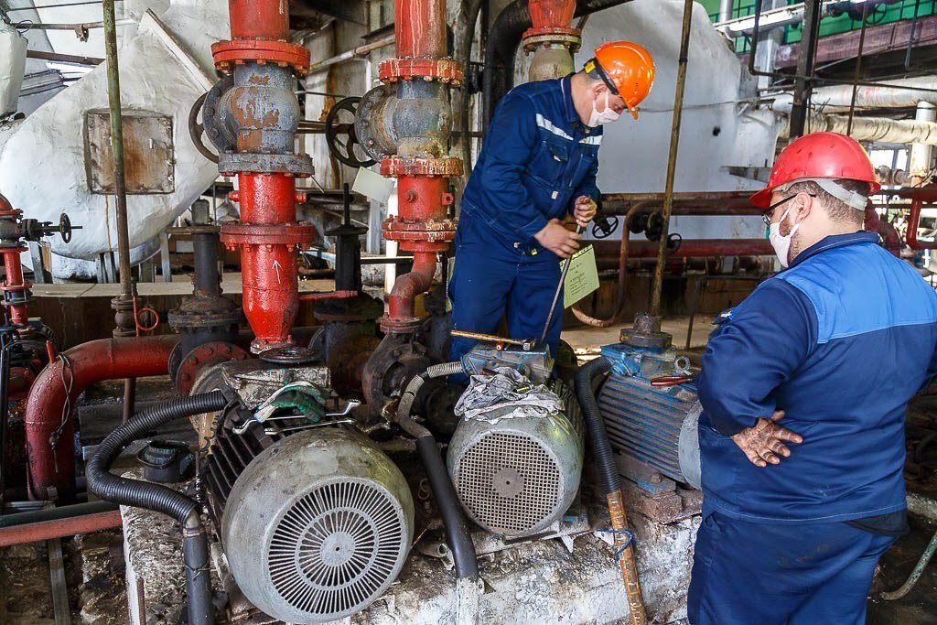
Applications
For industrial purpose, it can protect the industrial loads from over and undervoltage.
We can use this protection system in home to protect the home appliances.

Slide 42
Limitations
Due to LV25P, the all over cost of project is increased.
The proposed project is not detecting phase and frequency.
Leads to losses in the electrical circuit.
Fluctuations can cause great impact to the power quality.

Slide 43
Future scope
PHASE LOCKED LOOP METHOD
For phase detection
Frequency detection
Smart uvov protection system
We can interface to IOT Using gsm module and gps .

Slide 44
ADVANTAGES
Prevent load from damaging
When considering industrial purpose , we prevent heavy loads from damaging.
It is a reliable circuit
Complete elimination of man power .
Auto switch OFF at abnormal conditions

Slide 45
THANK YOU

